Slide 1
[CS1104]: Data Structure and Algorithms

Slide 2
Basic Terminologies & Introduction to Algorithm and Data Organization
UNIT -I

Slide 3
What is an algorithm?
The idea behind the computer program
Stays the same independent of
Which kind of hardware it is running on
Which programming language it is written in
Solves a well-specified problem in a general way
Is specified by
Describing the set of instances (input) it must work on
Describing the desired properties of the output

Slide 4
What is an algorithm? (Cont’d)
Before a computer can perform a task, it must have an algorithm that tells it what to do.
Informally: “An algorithm is a set of steps that define how a task is performed.”
Formally: “An algorithm is an ordered set of unambiguous executable steps, defining a terminating process.”
Ordered set of steps: structure!
Executable steps: doable!
Unambiguous steps: follow the directions!
Terminating: must have an end!

Slide 5
Basic Concepts
Overview: System Life Cycle
Algorithm Specification
Data Abstraction
Performance Analysis
Performance Measurement

Slide 6
1.1 Overview: system life cycle (1/2)
Good programmers regard large-scale computer programs as systems that contain many complex interacting parts.
As systems, these programs undergo a development process called the system life cycle.

Slide 7
1.1 Overview (2/2)
We consider this cycle as consisting of five phases.
Requirements
Analysis: bottom-up vs. top-down
Design: data objects and operations
Refinement and Coding
Verification
Program Proving
Testing
Debugging

Slide 8
1.2 Algorithm Specification (1/10)
1.2.1 Introduction
An algorithm is a finite set of instructions that accomplishes a particular task.
Criteria
input: zero or more quantities that are externally supplied
output: at least one quantity is produced
definiteness: clear and unambiguous
finiteness: terminate after a finite number of steps
effectiveness: instruction is basic enough to be carried out
A program does not have to satisfy the finiteness criteria.

Slide 9
1.2 Algorithm Specification (2/10)
Representation
A natural language, like English or Chinese.
A graphic, like flowcharts.
A computer language, like C.
Algorithms + Data structures = Programs [Niklus Wirth]
Sequential search vs. Binary search

Slide 10
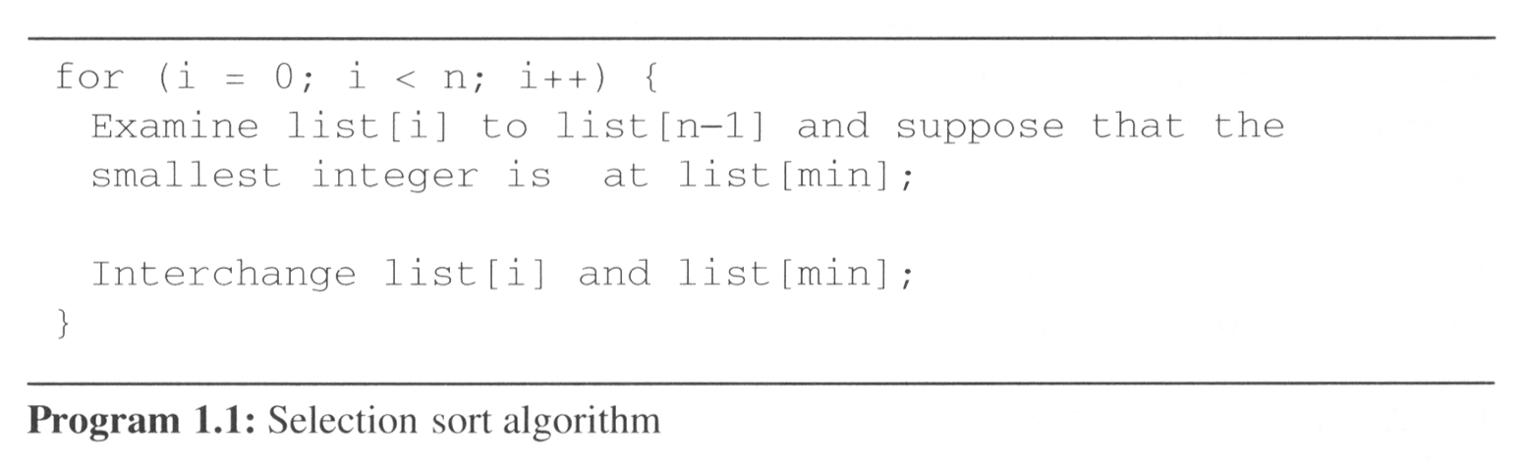
1.2 Algorithm Specification (3/10)
Example 1.1 [Selection sort]:
From those integers that are currently unsorted, find the smallest and place it next in the sorted list.
i [0] [1] [2] [3] [4]
- 30 10 50 40 20
0 10 30 50 40 20
1 10 20 40 50 30
2 10 20 30 40 50
3 10 20 30 40 50

Slide 11
Important Properties of Algorithms
Correct
always returns the desired output for all legal instances of the problem.
Unambiguous
Precise
Efficient
Can be measured in terms of
Time
Space
Time tends to be more important

Slide 12
Representation of Algorithms
A single algorithm can be represented in many ways:
Formulas: F = (9/5)C + 32
Words: Multiply the Celsius by 9/5 and add 32.
Flow Charts.
Pseudo-code.
In each case, the algorithm stays the same; the implementation differs!

Slide 13
Representation of Algorithms (Cont’d)
A program is a representation of an algorithm designed for computer applications.
Process: Activity of executing a program, or execute the algorithm represented by the program
➔ Process: Activity of executing an algorithm.

Slide 14
Expressing Algorithms
English description
Pseudo-code
High-level programming language
More
precise
More easily expressed

Slide 15
Pseudocode
Pseudocode is like a programming language but its rules are less stringent.
Written as a combination of English and programming constructs
Based on selection (if, switch) and iteration (while, repeat) constructs in high-level programming languages
Design using these high level primitives
Independent of actual programming language

Slide 16
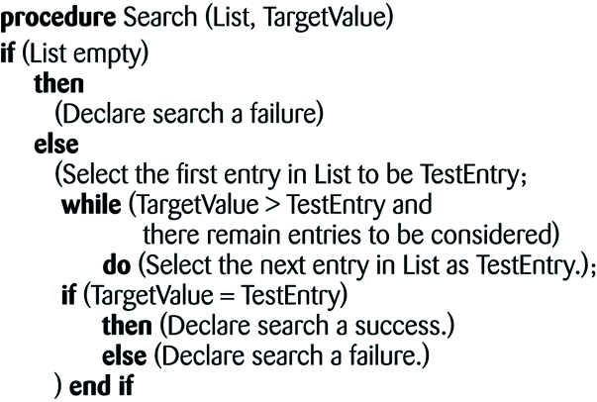
Pseudocode (Cont’d)
Example: The sequential search algorithm in pseudocode

Slide 17
Algorithm Discovery
The Two Steps of Program Development:
1. Discover the algorithm.
2. Represent the algorithm as a program.
Step 2 is the easy step!
Step 1 can be very difficult!
To discover an algorithm is to solve the problem!

Slide 18
Problem Solving: A creative process
Problem solving techniques are not unique to Computer Science.
The CS field has joined with other fields to try to solve problems better.
Ideally, there should be an algorithm to find/develop algorithms.
However, this is not the case as some problems do not have algorithmic solutions.
Problem solving remains an art!

Slide 19
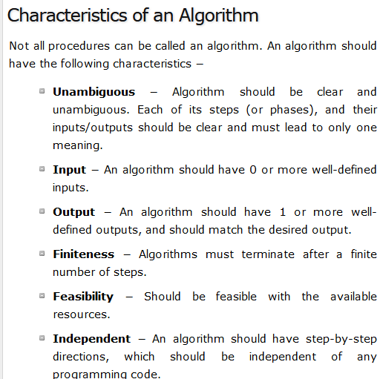

Slide 20
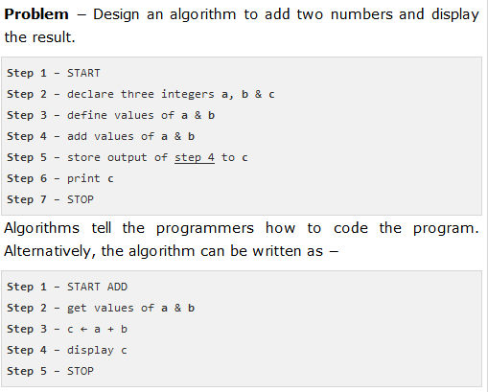

Slide 21
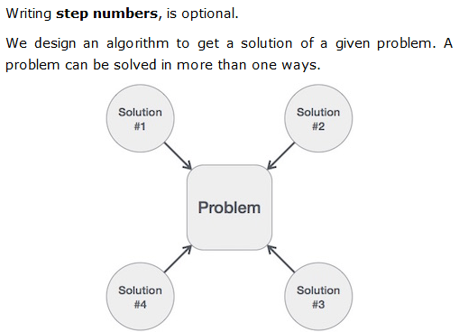

Slide 22
Recursion

Slide 23
Introduction
A programming technique in which a function calls itself.
One of the most effective techniques in programming.

Slide 24
Triangular Numbers
Consider the numbers 1, 3, 6, 10, 15….
What is so peculiar about them?
The n^{th} term in the series is obtained by adding n to the previous number.
Recursion can be used to find the nth term.

Slide 25
Finding nth Term
Using Loop int triangle(int n) { int total = 0; while (n > 0) { total = total + n; --n; } return total; } | Using Recursion int triangle(int n) { if(n == 1) { return 1; } else return(n + triangle(n-1)); }

Slide 26
Our observation (between loop vs. recursion)
If a loop is used, the method cycles around the loop n times, adding n to the total the first time, n-1 the second time and so on, down to 1, quitting the loop when n becomes 0.
If recursion is used, then a base case is used that determines when the recursion ends.

Slide 27
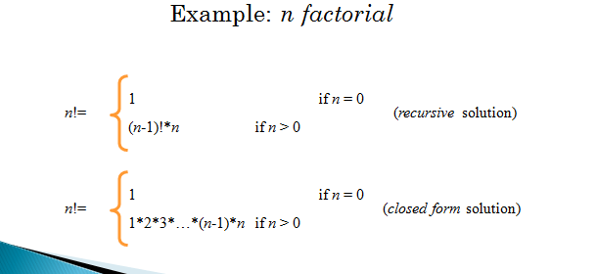
Problems defined recursively
There are many problems whose solution can be defined recursively

Slide 28
Coding the factorial function
Recursive implementation
int Factorial(int n)
{
if (n==0) // base case
return 1;
else
return n * Factorial(n-1);
}

Slide 29
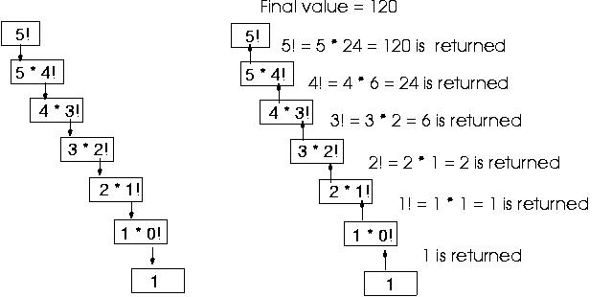

Slide 30
Characteristics of Recursive Methods
The recursive method calls itself to solve a smaller problem.
The base case is the smallest problem that the routine solves and the value is returned to the calling method. (Terminal condition)
Calling a method involves certain overhead in transferring the control to the beginning of the method and in storing the information of the return point.
Memory is used to store all the intermediate arguments and return values on the internal stack.
The most important advantage is that it simplifies the problem conceptually.

Slide 31
Analysis Of Algorithm
By
A. H. Hingmire

Slide 32
Performance Analysis
Space Complexity: The space complexity of a program is the amount of memory it needs to run to completion.
Time Complexity: The time complexity of a program is the amount of computer time it needs to run to completion.

Slide 33
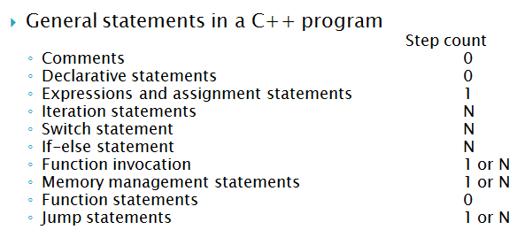
Time Complexity in C

Slide 34
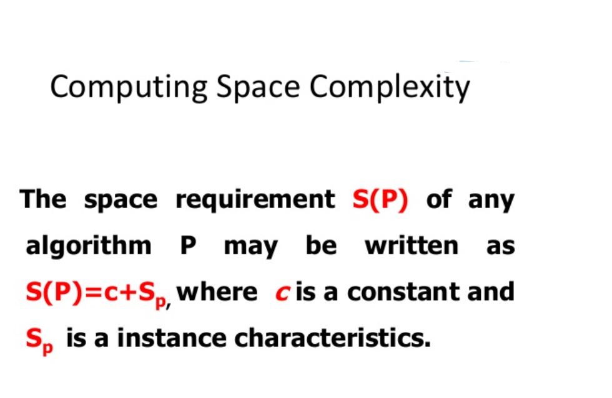
Space Complexity S(P)=C+S_{P}(I)

Slide 35
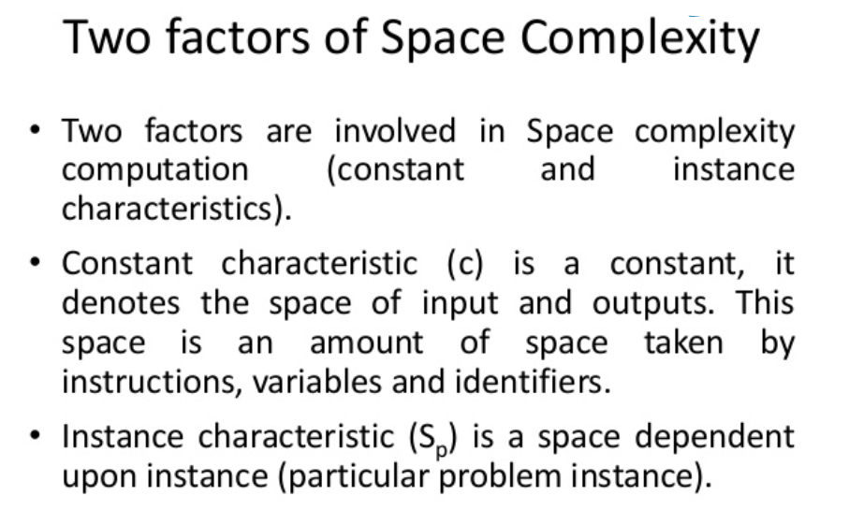
Performance analysis: Space

Slide 36
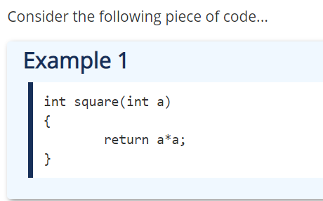
Performance analysis: Space
In the above piece of code, it requires 2 bytes of memory to store variable 'a' and another 2 bytes of memory is used for return value.

Slide 37
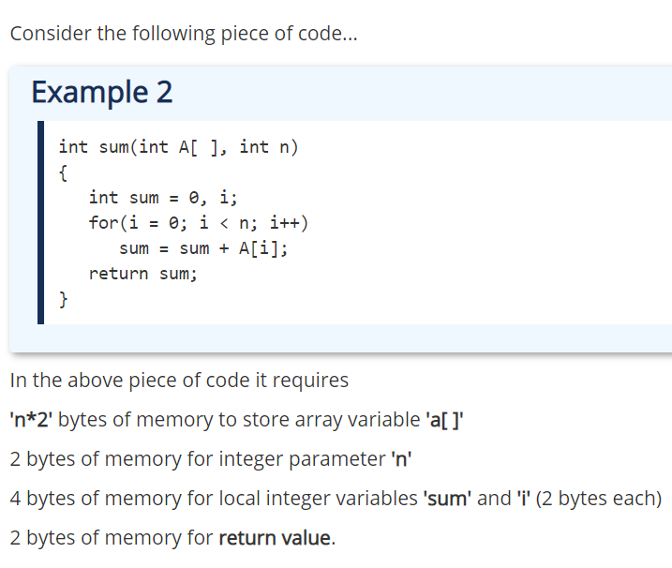
Performance analysis: Space

Slide 38
1.4 Performance analysis: Time
1.4.2 Time Complexity:
T(P)=C+T_{P}(I)
The time, T(P), taken by a program, P, is the sum of its compile time C and its run (or execution) time, T_{P}(I)
Fixed time requirements
Compile time (C), independent of instance characteristics
Variable time requirements
Run (execution) time T_{P}
T_{P}(n)=c_{a}ADD(n)+c_{s}SUB(n)+c_{l}LDA(n)+c_{st}STA(n)

Slide 39
1.4 Performance analysis: Time
A program step is a syntactically or semantically meaningful program segment whose execution time is independent of the instance characteristics.
Example (Regard as the same unit machine independent)
abc = a + b + b * c + (a + b - c) / (a + b) + 4.0
abc = a + b + c
Methods to compute the step count
Introduce variable count into programs
Tabular method
Determine the total number of steps contributed by each statement step per execution × frequency
add up the contribution of all statements

Slide 40
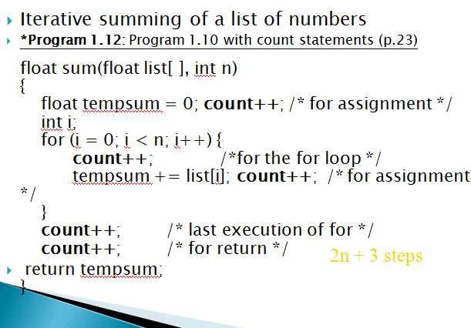
1.4 Performance analysis (7/17)
2n + 3 steps

Slide 41
1.4 Performance analysis (8/17)
Tabular Method
*Figure 1.2: Step count table for Program 1.10 (p.26)
steps/execution
Iterative function to sum a list of numbers

Slide 42
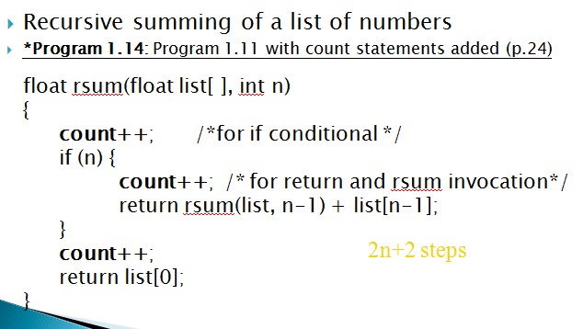
1.4 Performance analysis (9/17)
2n+2 steps

Slide 43
1.4 Performance analysis (10/17)
*Figure 1.3: Step count table for recursive summing function (p.27)

Slide 44
Asymptotic Notation
Asymptotic notations are the mathematical notations used to describe the running time of an algorithm when the input tends towards a particular value or a limiting value.
THREE types of Asymptotic Notations and those are as follows...
Big - Oh (O)
Big - Omega (Ω)
Big - Theta (Θ)

Slide 45
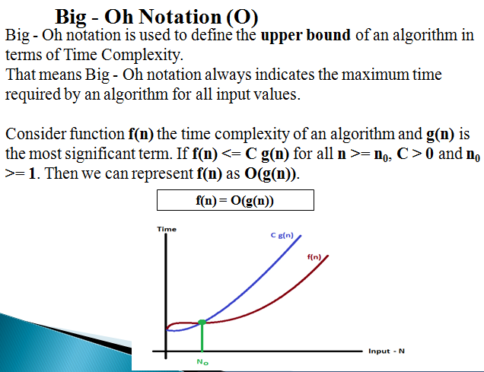

Slide 46
Example
Consider the following f(n) and g(n)... f(n) = 3n + 2 g(n) = n If we want to represent f(n) as O(g(n)) then it must satisfy
f(n) <= C x g(n) for all values of C > 0 and n₀>= 1
f(n) <= C g(n) ⇒3n + 2 <= C n Above condition is always TRUE for all values of C = 4 and n >= 2. By using Big - Oh notation we can represent the time complexity as follows... 3n + 2 = O(n)

Slide 47
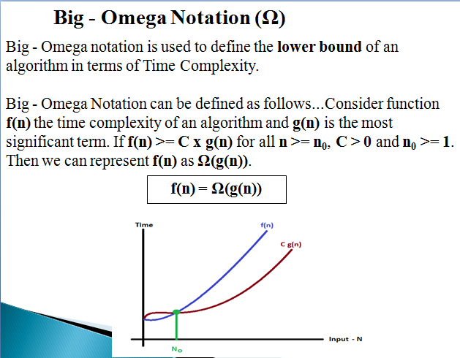

Slide 48
Example
Consider the following f(n) and g(n)... f(n) = 3n + 2 g(n) = n If we want to represent f(n) as Ω(g(n)) then it must satisfy f(n) >= C g(n) for all values of C > 0 and n₀>= 1
f(n) >= C g(n) ⇒3n + 2 <= C n Above condition is always TRUE for all values of C = 1 and n >= 1. By using Big - Omega notation we can represent the time complexity as follows... 3n + 2 = Ω(n)

Slide 49
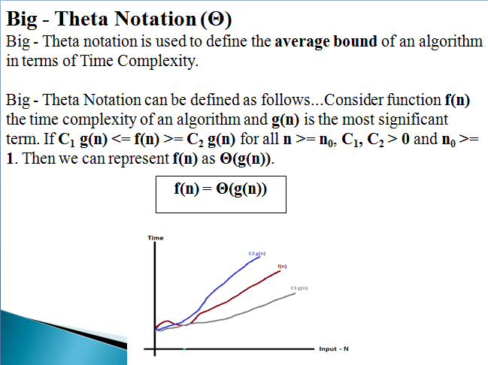
<

Slide 50
Example
Consider the following f(n) and g(n)... f(n) = 3n + 2 g(n) = n If we want to represent f(n) as Θ(g(n)) then it must satisfy C₁ g(n) <= f(n) <= C₂ g(n) for all values of C₁, C₂ > 0 and n₀>= 1
C₁ g(n) <= f(n) <= ⇒C₂ g(n) C₁ n <= 3n + 2 >= C₂ n Above condition is always TRUE for all values of C₁ = 1, C₂ = 4 and n >= 1. By using Big - Theta notation we can represent the time compexity as follows... 3n + 2 = Θ(n)

Slide 51
Data Abstraction
The concept of representing important details and hiding away the implementation details is called data abstraction.
An abstract data type or ADT is a collection of data and a set of operations on the data that does not specify how the data is stored or how the operations accomplish their functions.

Slide 52
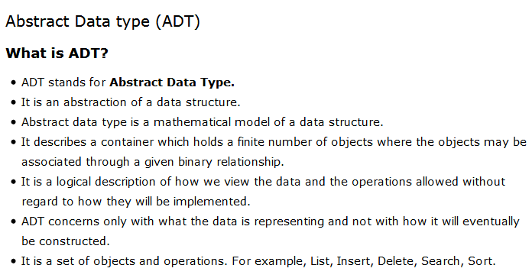

Slide 53
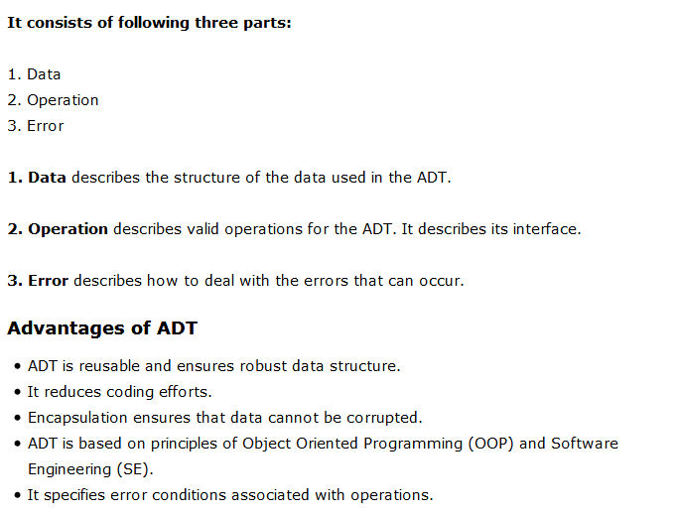

Slide 54
Let us see some operations of Stack ADT −
isFull(), This is used to check whether stack is full or not
isEmpry(), This is used to check whether stack is empty or not
push(x), This is used to push x into the stack
pop(), This is used to delete one element from top of the stack
peek(), This is used to get the top most element of the stack
size(), this function is used to get number of elements present into the stack

Slide 55
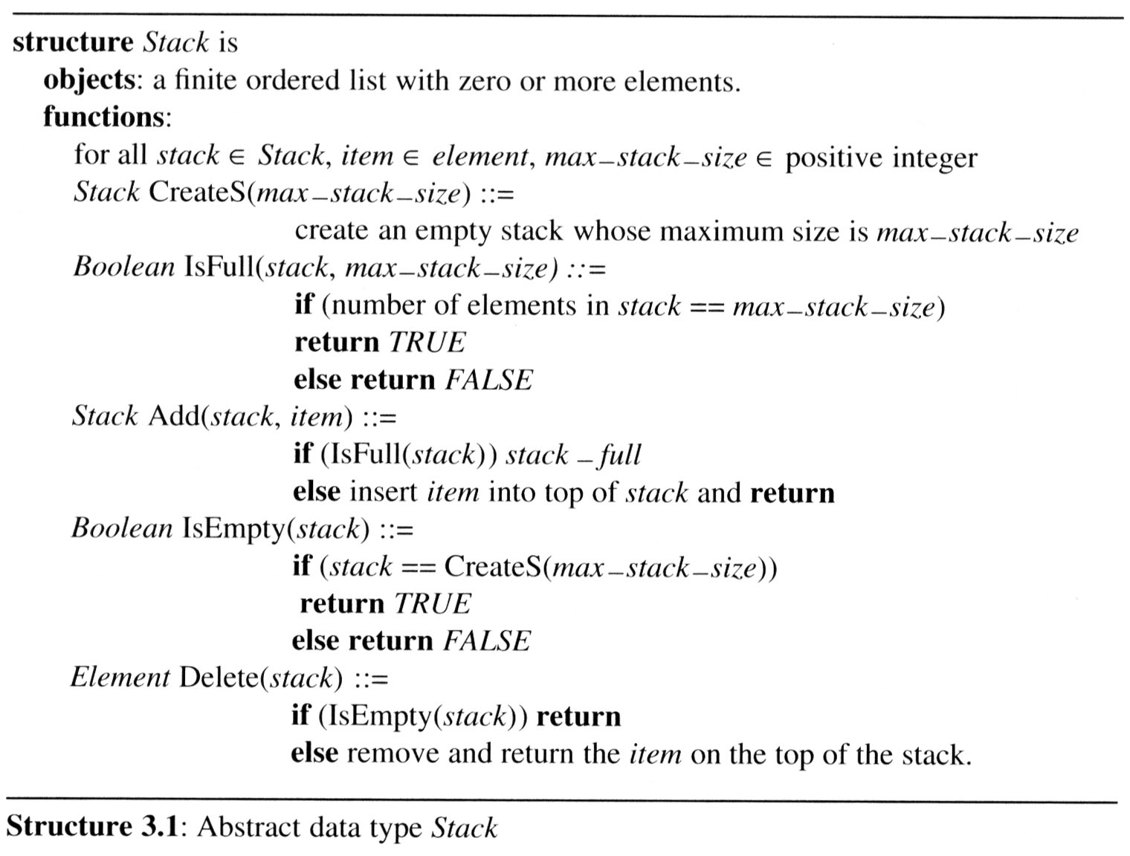

Slide 56
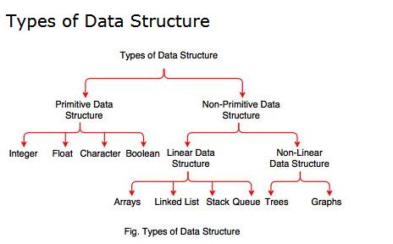

Slide 57
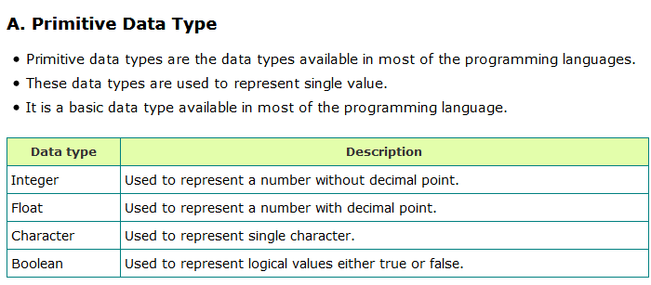

Slide 58
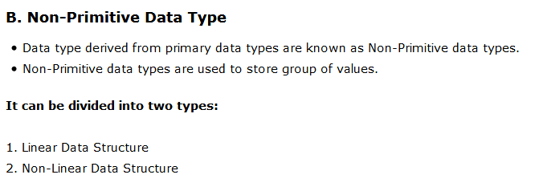

Slide 59
Liner Data Structure
A Linear data structure have data elements arranged in sequential manner and each member element is connected to its previous and next element.
This connection helps to traverse a linear data structure in a single level and in single run.
Such data structures are easy to implement as computer memory is also sequential.
Examples of linear data structures are List, Queue, Stack, Array etc.

Slide 60
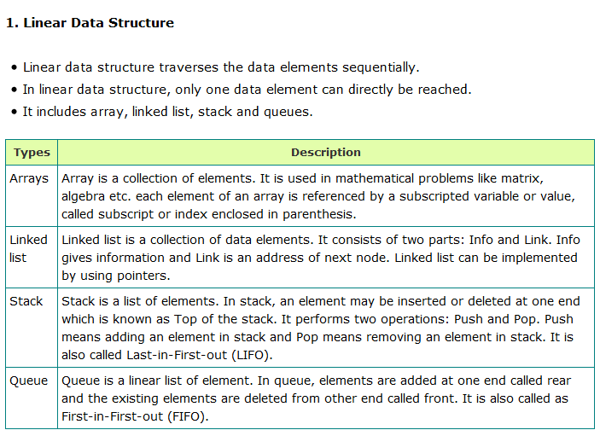

Slide 61
Non-linear Data Structures
A non-linear data structure has no set sequence of connecting all its elements and each element can have multiple paths to connect to other elements.
Such data structures supports multi-level storage and often cannot be traversed in single run.
Such data structures are not easy to implement but are more efficient in utilizing computer memory.

Slide 62
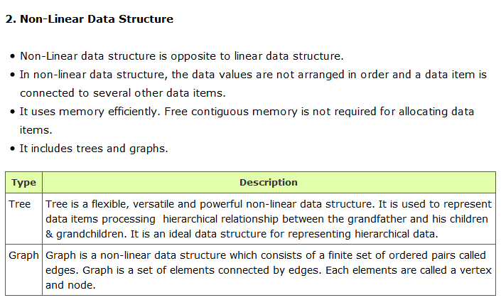

Slide 63
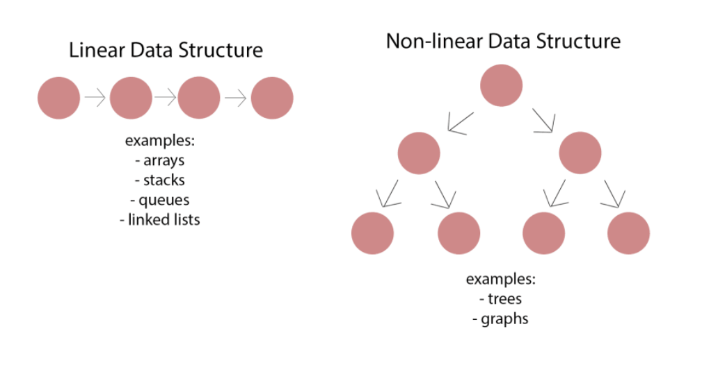

Slide 64
Sr. No. | Key | Linear Data Structures | Non-linear Data Structures
1 | Data Element Arrangement | In linear data structure, data elements are sequentially connected and each element is traversable through a single run. | In non-linear data structure, data elements are hierarchically connected and are present at various levels.
2 | Levels | In linear data structure, all data elements are present at a single level. | In non-linear data structure, data elements are present at multiple levels.
3 | Implementation complexity | Linear data structures are easier to implement. | Non-linear data structures are difficult to understand and implement as compared to linear data structures.
4 | Traversal | Linear data structures can be traversed completely in a single run. | Non-linear data structures are not easy to traverse and needs multiple runs to be traversed completely.
5 | Memory utilization | Linear data structures are not very memory friendly and are not utilizing memory efficiently. | Non-linear data structures uses memory very efficiently.
6 | Time Complexity | Time complexity of linear data structure often increases with increase in size. | Time complexity of non-linear data structure often remain with increase in size.
7 | Examples | Array, List, Queue, Stack. | Graph, Map, Tree.

Slide 65
Thank You!

